Slide 1
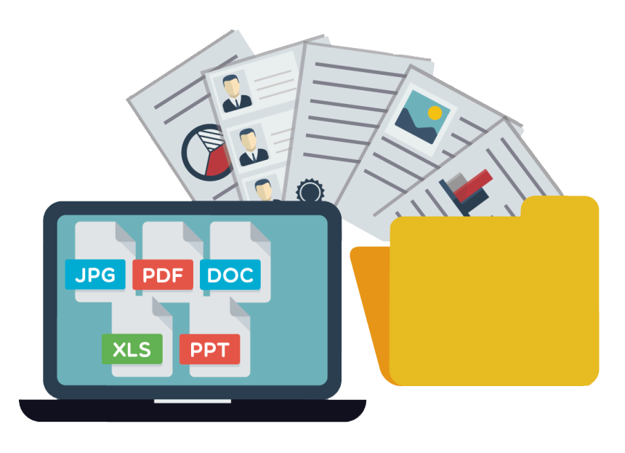
ServoDocs®
Enterprise Wide Document Management System

Slide 2

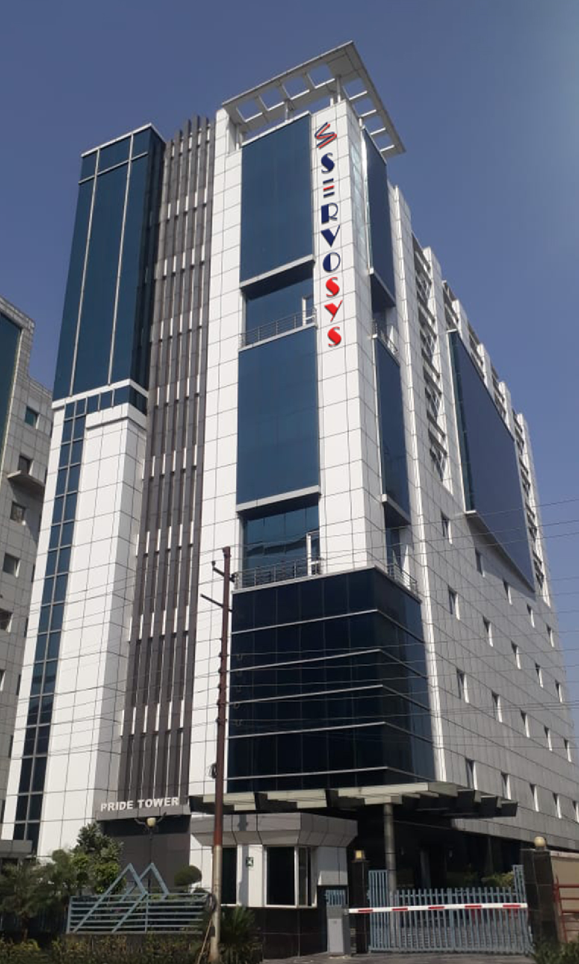
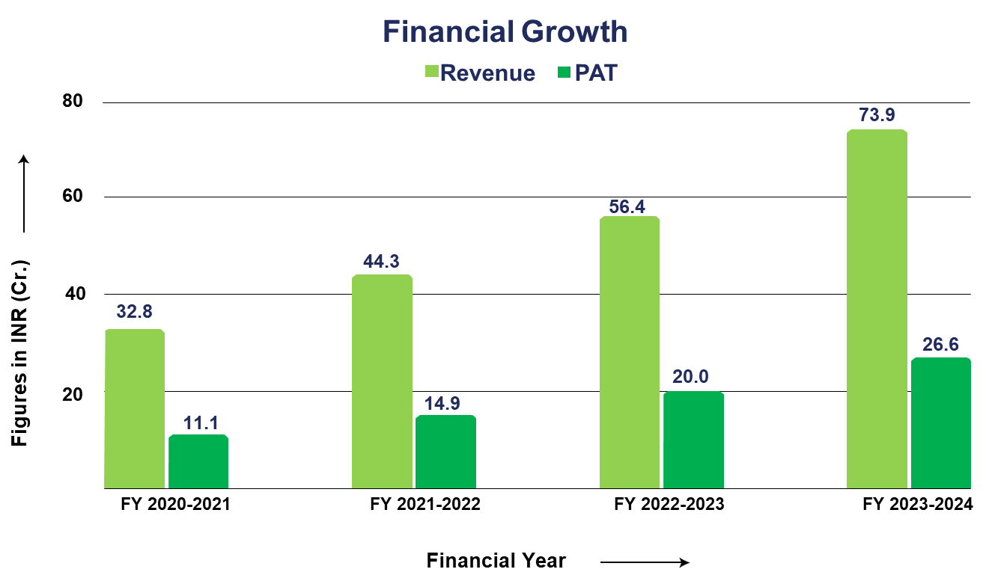
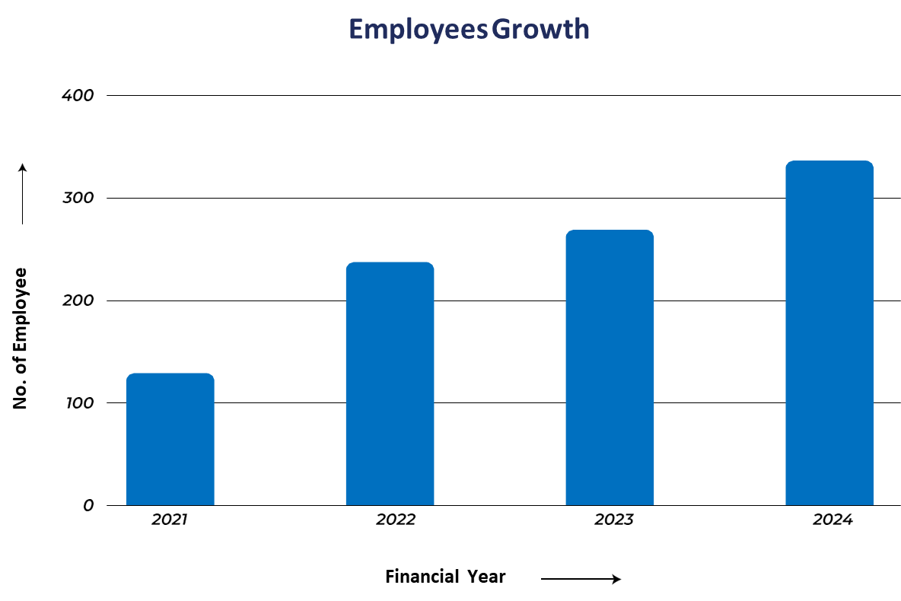
Servosys Solutions
Indian Software Product Company
Corporate Office - Noida,
Regional Office - Mumbai
300+ Employees
200+ Processes
12+ Yrs Operations

Slide 3

Glimpse of Servosys Platform & Solutions
Digital Lending
Digital Banking
Regulatory Solutions (RBI)
Loan Origination System LOS
Onboarding Solution
Aadhaar Masking/PII Encryption
Corporate
SME | MSME
Retail
Savings Account – Individual/ Joint
Microfinance
Credit Card Issuance
Enterprise Document Management
Current Account
Personal/ Vehicle/ Gold/ Consumer Durable
RERA Reporting (CFPM)
Home Loan | LAP | Mortgage
FD /RD/ TD/ DDS/ MD
Early Warning System (EWS)
Agri KCC – Kisaan Credit Card
Customer Service Request/
Online Dispute Resolution
Asset Reconstruction Company Solution
Construction Finance Project Monitoring
Low Code BPM Platform
In-built BRE
Dynamic Doc Generation
Audit Trails
Routing Rule Engine
Future Ready
3rd Party App Integration
Dashboard & MIS
Quality & Security : CMMI Level 3, ISO 9001, ISO 27001, ISO 27701, ISO 20000, ISO 22301

Slide 4


















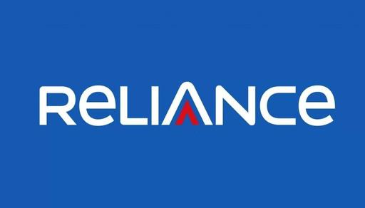

Our Valued Customers
ASSET RECONSTRUCTION
COMPANY LTD.

Slide 5
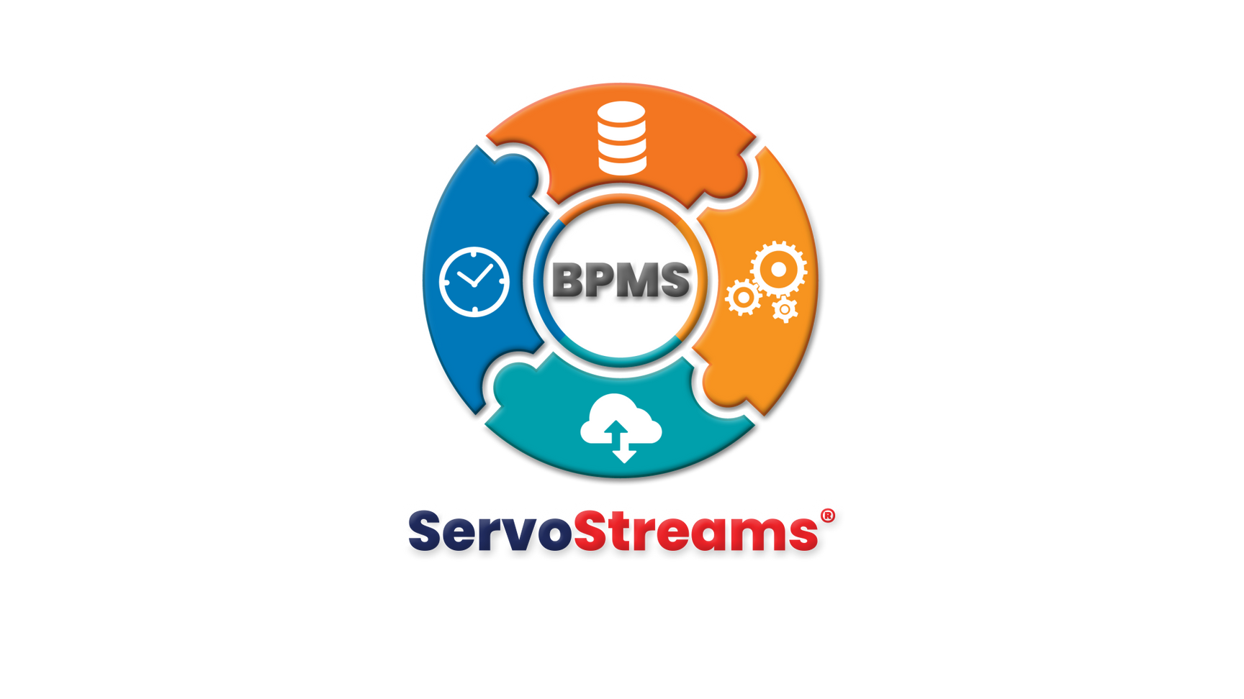
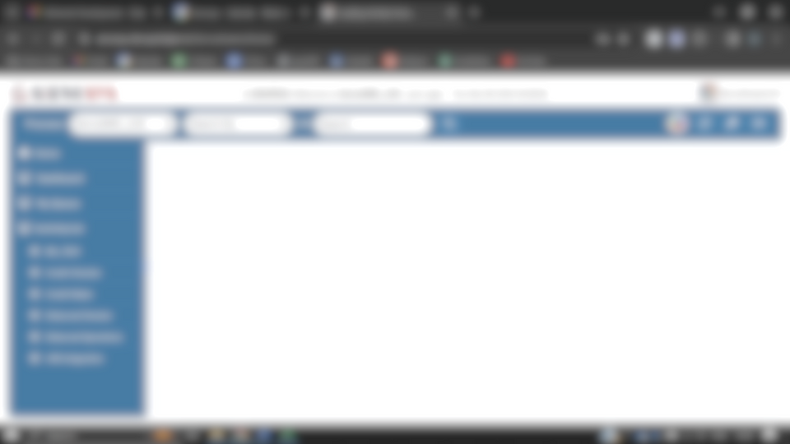
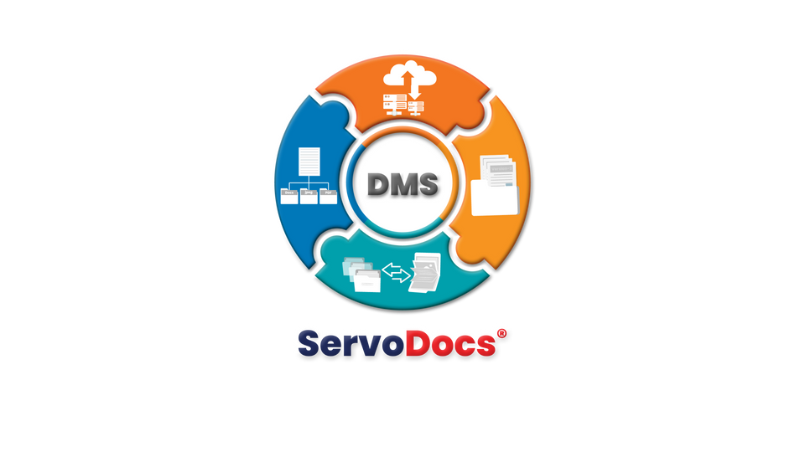
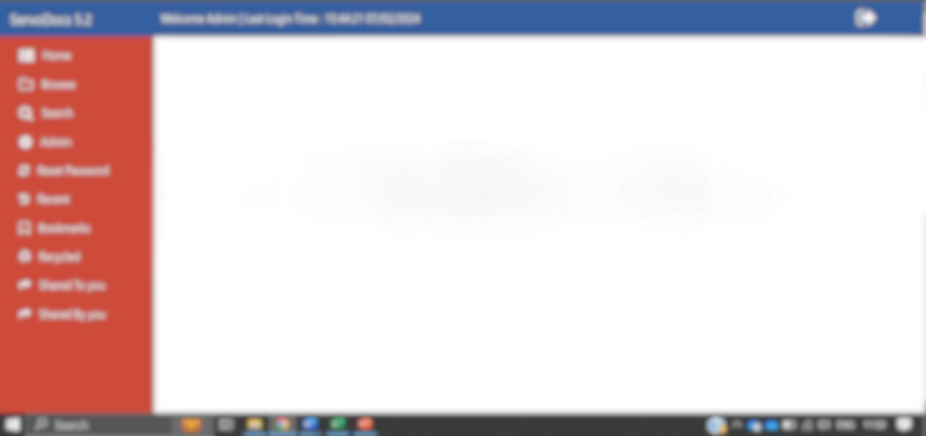
Servosys Products
Low Code BPM Platform
Enterprise-wide DMS
End-to-End Workflow Automation
Document Lifecycle Management

Slide 6
ServoDocs®
Enterprise Document Management System

Slide 7















ServoDocs EDMS
ServoDocs®
Enterprise Document Management System
Document Versioning with check In & Check out
I
A
NDEXING
Document Encryption & Encrypted Storage: AES256 encryption
RCHIVE
Enterprise class indexing and searching features
A central repository to store all business documents together
Integration APIs
Login API
Create Folder API
Upload Document API
Get Document API
Logout API
Secure Document Sharing via Authenticated Link
R
ETREIVE
Locate right documents and information easily and instantly
Metadata-based Rights: Manage user rights
Zero Starvation & blocks with parallel read/ write support
Integrations: API, ESB, SFTP, Flatfile, DB Link, WebService, OSB, LDAP

Slide 8













Key Features of EDMS
ServoDocs®
Key to Smart Document Management
Auto Indexing: Barcode, QR, MICR, CSVs
Annotations: Highlight, stamp on TIFF/JPG
Bulk Upload/Download: Via Excel/CSV
Over the Cloud/ On Premise
Microservices/ Monolithic Architecture
Store Anywhere/ Everywhere - Azure, S3, SAN, NAS, Cloud object storages
Masking Confidential Information & Overwrite instead of Versioning
Admin Dashboard: Users, rights, audit trails
Document Purging: Deletion or restricted access

Slide 9

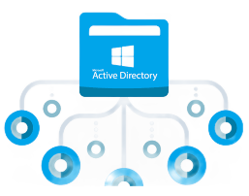




Key Features of EDMS
Users & Group Management: Many-to-many relationship between users and groups.
Metadata Definitions: Define document types, max size, associated parameters, and mandatory fields.
Rights Management: Assign rights to metadata linked with documents and folders.
Folder Structure: Hierarchical folders organized and linked to metadata definitions to regulate uploads.
Check-In/Check-Out: Prevent concurrent edits by checking out documents; check-in to update with new versions.
Advanced/Global Search: Search documents and folders by Document ID, text, folder name, metadata; supports saved and wildcard searches.
ServoDocs®
Enterprise Document Management System

Slide 10




Key Features of EDMS
In-Built Viewer: Web-based viewer supports standard documents (JPEG, JPG, TIFF, GIF, PDF, mp4) and password-protected PDFs.
Document Versioning: Create multiple versions of a document, supporting different file types.
Audit Trail: Maintains a complete audit trail for compliance.
Folder Freeze/Unfreeze: Restrict or resume activity in folders or entire folder threads.
Bulk Upload/Download: Upload or download multiple documents simultaneously, saving time and effort.
DMS Annotations: Add notes, highlights, and other annotations on top of documents.
Archiving/ Purging: Archive and purge outdated or unused documents to free up space and ensure secure storage.
Enterprise Document Management System
ServoDocs®

Slide 11


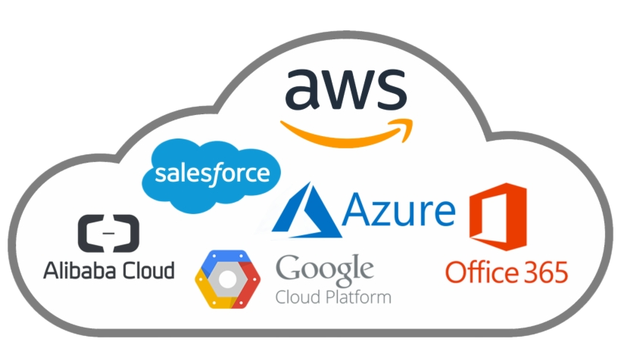
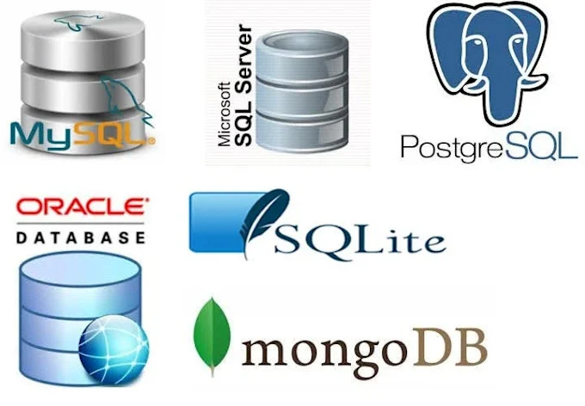






Technical Features of EDMS
Microservices Architecture: Enhances scalability, flexibility, and maintainability.
Docker & Kubernetes Support: Efficient and reliable deployment across environments.
Cloud & Environment Flexibility: EDMS can utilize AWS (S3, EC2, RDS), Azure (Blob Storage, VMs, SQL Database), GCP (Cloud Storage, Compute Engine, Cloud SQL), and other cloud/on-prem environments as per client’s choice, ensuring it can handle large volumes of documents and scale according to needs
DB Support: Oracle, MSSQL, PostgreSQL - provides more agility.
Server Support: JBoss, WebLogic, WildFly, Apache Tomcat – multi-server support for agility.
Active Directory Support
  LDAP Users: Password policy managed by Active Directory.
  Non-LDAP Users: Password policy managed by ServoDocs.
Enterprise Document Management System
ServoDocs®

Slide 12
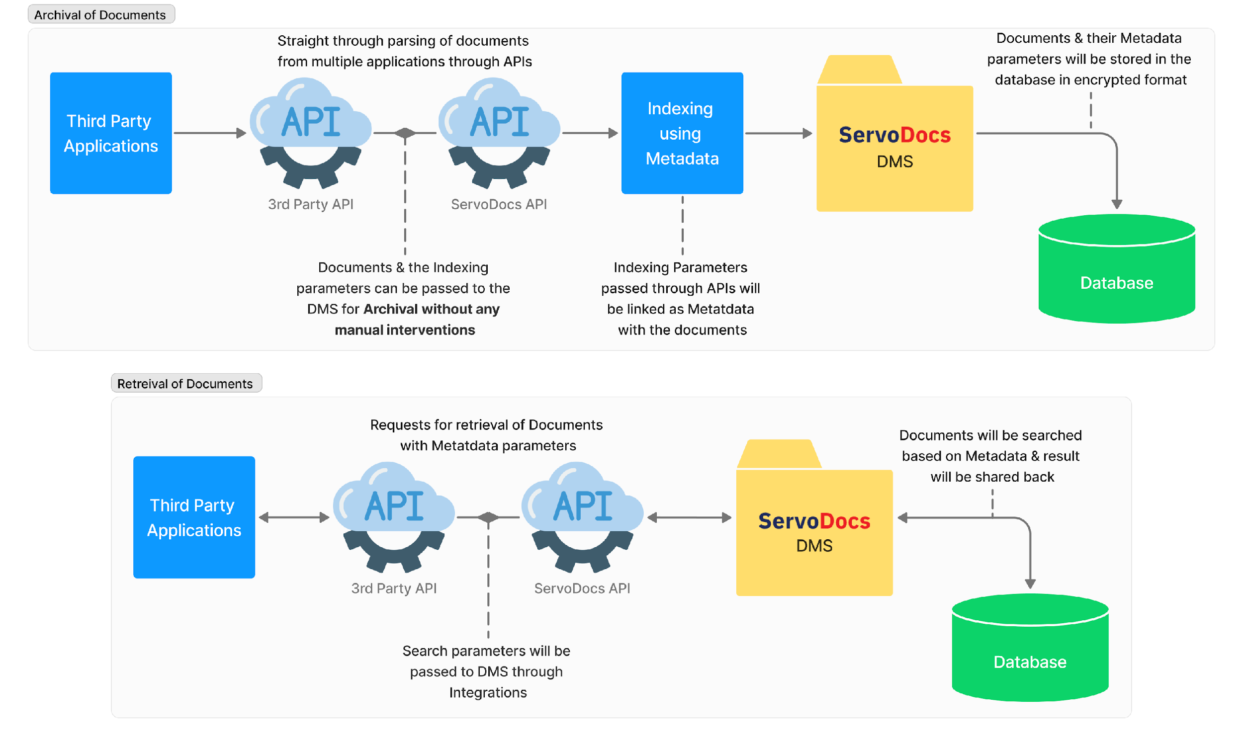
Straight Through Documents Archival/ Retrieval Process
ServoDocs®
Enterprise Document Management System

Slide 13



Key Features of DMS
Multi Data source Connectivity: Create separate databases for Each LOB separating LOBs in other databases/ Services.
  Benefits:
    Multiple LOB integration with respect to LOB data seamlessly integrated
    Real time and offline data exchange
Replication Services: Replicate the document from DC to DR using Servosys Provided Utility.
    Benefits:
    Failover mechanism in place
    No cut-off from real time data connectivity and continuity, no downtime as such
    Updated Documents are accessible always
Enhanced Document Storage: More robust and scalable document storage with enhanced security
  Benefits:
    More capacity to store document load
    Enhanced storage support provides all the documents (old & New)
ServoDocs®
Enterprise Document Management System

Slide 14





Digital Document Management:
Reduce Operational Costs by 75%
About Customer
One of Asia’s largest NBFC in Asia with many Financial Services as offerings with 150 Billion USD in Asset Under Management (AUM).
Business Challenge
Solution Delivered
High Down times & delayed response
Less API Friendly, Less Secure, High Risk
No Version Control & improper Indexing
Single central Repository, with quick response times
10 TB data Migration from multiple applications to ServoDocs
Metadata Indexing for structured archival & quick retrieval
INSTANT DOCUMENT ACCESS
75% Cost Reduction
Handle High Load & Volume
Benefits
increased productivity due to lower time lags & indexing
Operational cost and hardware cost reduction by cloud compatibility.
Managing more than 60 TB of scanned & compressed Documents swiftly
ServoDocs®
Enterprise Document Management System

Slide 15
Growth Story @ KVB
ServoDocs®
Enterprise Document Management System

Slide 16

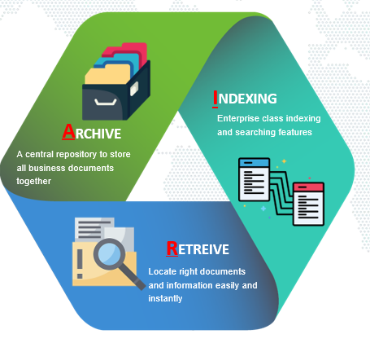
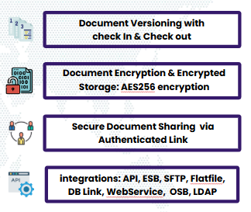




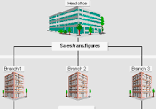
“Enterprise DMS Deployment at One of India's Leading Banks"
Growth Story @KVB
2018
180 Mn
Mobile
800+
Launched
Files uploaded
Journey
Branches
DMS Journey begins and continues to grow
File Volume: Files uploaded, amounting to 52 TB
Mobile app integrates for KYC recheck to store
KVB utilizes ServoDocs DMS in across 800+ branches
ServoDocs®
Enterprise Document Management System

Slide 17

"YoY Growth: The Remarkable Journey of ServoDocs"
2018-19
2019-20
2020-21
2021-22
2022-23
2023-24
4Mn Files uploaded
Across
3 LOBs
6.2Mn Files uploaded
across
6 LOBs
12Mn Files uploaded
across
7 LOBs
19Mn Files uploaded
across
9 LOBs
48.6Mn Files uploaded
across
15 LOBs
40 Mn Files uploaded
across
16 LOBs
Since 2018, 16 new lines of business have been added, generating a cumulative 52TB of files.
ServoDocs®
Enterprise Document Management System

Slide 18
Growth Story @ L&T Finance
ServoDocs®
Enterprise Document Management System

Slide 19

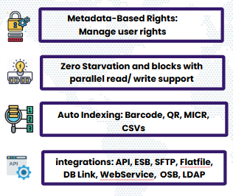
“Enterprise DMS Deployment at One of India's Leading NBFC "
Growth Story @L&T Finance
2017
180 Mn
Mobile
200+
Launched
Files Uploaded
Journey
Branches
DMS Journey begins and continues to grow by leaps & Bounds
File Volume: Files uploaded, amounting to 138 TB a mammoth growth
Mobile app for DSA, field staff for speedy onboarding & faster KYC
L&T Finance utilizes ServoDocs DMS in across 200+ branches
ServoDocs®
Enterprise Document Management System

Slide 20
"YoY Growth: The Remarkable Journey of ServoDocs"
2018-19
2019-20
2020-21
2021-22
2022-23
2023-24
40 Mn Files uploaded
Across
6 LOBs
34 Mn Files uploaded
across
6 LOBs
48 Mn Files uploaded
across
7 LOBs
141 Mn Files uploaded
across
8 LOBs
143 Mn Files uploaded
across
9 LOBs
101 Mn Files uploaded
across
13 LOBs so far
Since 2018, 13 new lines of business have been added, generating a cumulative 138 TB of files.
ServoDocs®
Enterprise Document Management System

Slide 21
Growth Story @ Suryoday Bank
ServoDocs®
Enterprise Document Management System

Slide 22

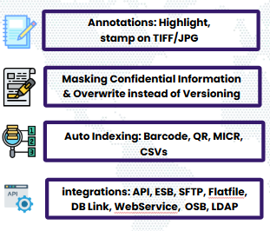
“Enterprise DMS Deployment at One of India's Leading SMB"
Growth Story @Suryoday Bank
2018
10 Mn
Mobile
675+
Launched
Files uploaded
Journey
Branches
DMS Journey begins and continues to grow
File Volume: Files uploaded, amounting to 4 TB
Mobile app integrates for KYC recheck to store
Suryoday SMB utilizes ServoDocs DMS in across 675+ branches
ServoDocs®
Enterprise Document Management System

Slide 23
"YoY Growth: The Remarkable Journey of ServoDocs"
2020-21
2021-22
2022-23
2023-24
2.2 Mn Files uploaded
Across
3 LOBs
2.8 Mn Files uploaded
across
4 LOBs
5 Mn Files uploaded
across
4 LOBs
9.3 Mn Files uploaded
across
4 LOBs
Since 2020, 4 new lines of business have been added, generating a cumulative 4 TB of files.
ServoDocs®
Enterprise Document Management System

Slide 24


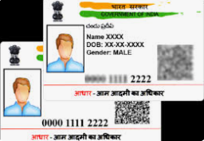
Support Services
Providing Product Updates:
  Periodic Product updates help the customer to have latest versions and features available for enhanced speed of operations
Supporting the Bank on Compliance:
  Compliance support service helps the customer to fulfil regulatory compliances
New API Integration:
  New APIs help the customer to have more integration options to multiple systems having APIs exposed
Aadhaar Masking API:
  Masking utility is a regulatory requirement and helps the customers to have an in hand readymade support to adhere Aadhaar masking needs for increased workload
ServoDocs®
Enterprise Document Management System

Slide 25
ServoDocs® Screens

Slide 26





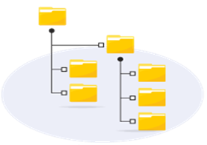
6 Steps to Deployment
Product Installation
Define Metadata Definition
Define Users and Groups
Expose API to 3rd Party System
Grant Rights
Set Folder Hierarchy
ServoDocs®
Enterprise Document Management System

Slide 27
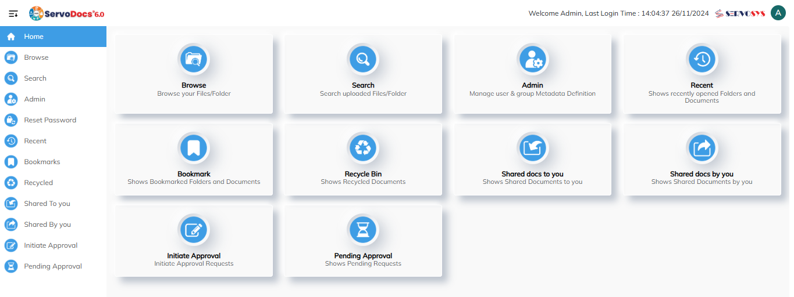
Home Page
ServoDocs®
Home Page:
Landing page with all tabs view
ServoDocs®
Enterprise Document Management System

Slide 28
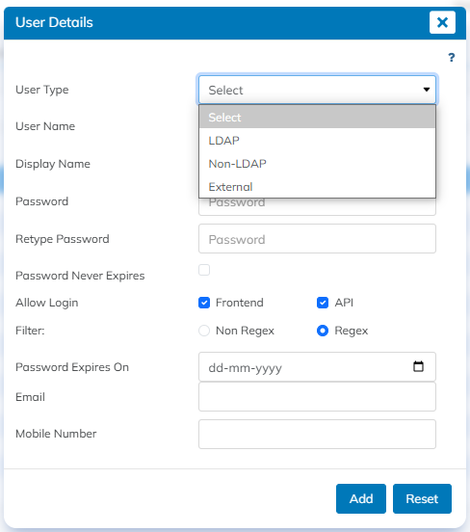
Support for Active Directory
ServoDocs®
LDAP Users:
The password policy is managed by Active Directory.
Non-LDAP Users:
The password policy is managed by ServoDocs.
ServoDocs®
Enterprise Document Management System

Slide 29
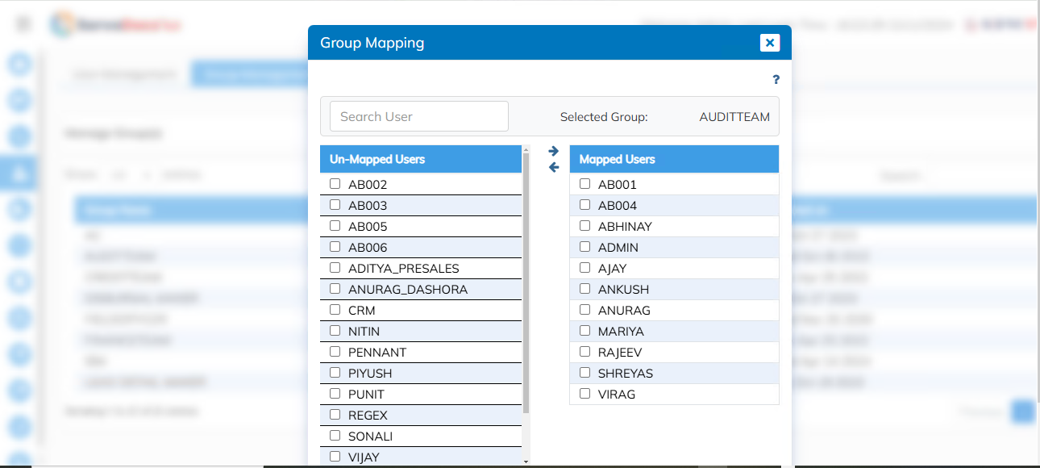
Group Management
ServoDocs®
Groups & Users can have a many-to-many relationship i.e., 1 group can have multiple users and 1 user can be part of multiple groups.
ServoDocs®
Enterprise Document Management System

Slide 30
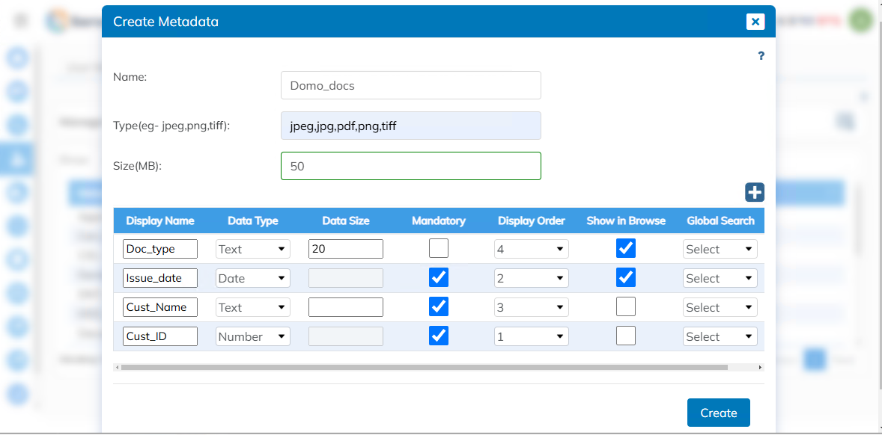
Metadata Definitions
ServoDocs®
Document Type Restriction allowed
Restrict maximum size of document
Create any number of associated parameters for indexing purpose
Define mandatory parameters
ServoDocs®
Enterprise Document Management System

Slide 31
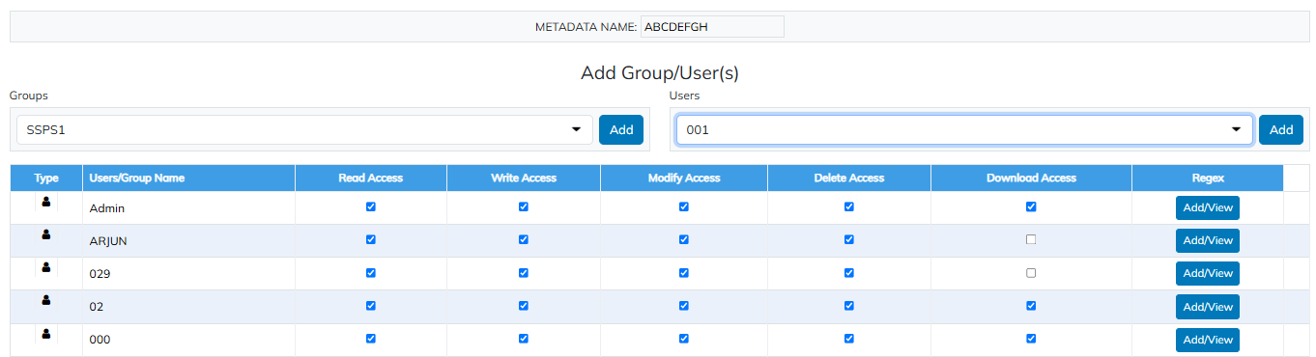
Rights Management
ServoDocs®
Define rights to metadata on the user and the group level, which gets associated with documents and folders. Example – View Rights, Download Rights, Delete Rights etc
ServoDocs®
Enterprise Document Management System

Slide 32
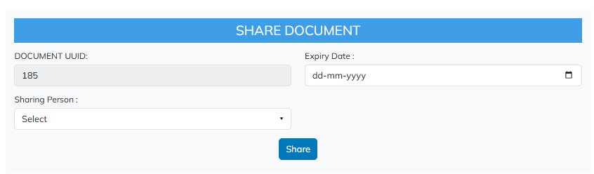
Document Sharing
ServoDocs®
Users can share the documents amongst each other for review via Link
ServoDocs®
Enterprise Document Management System

Slide 33
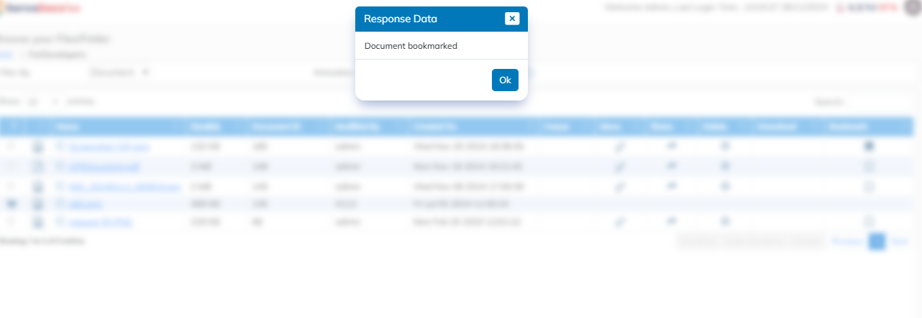
Document Bookmarking
ServoDocs®
Users can bookmark the documents which can be quickly accessed through the bookmark panel in the DMS.
ServoDocs®
Enterprise Document Management System

Slide 34
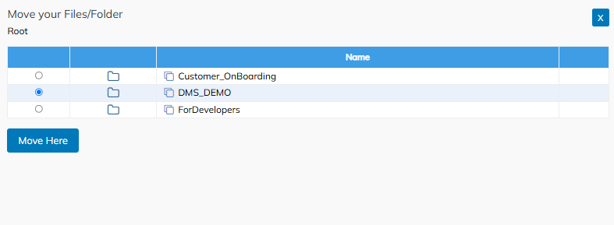
Document Moving
ServoDocs®
Documents can be moved from one folder to another as per the user convenience without hampering the metadata of the document.
ServoDocs®
Enterprise Document Management System

Slide 35
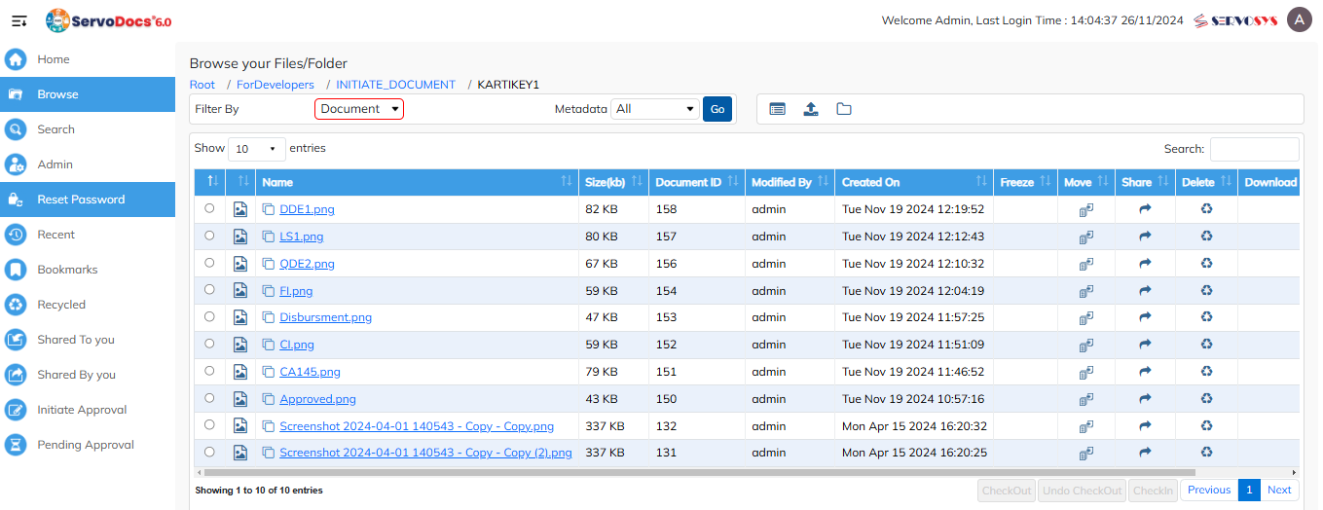
Folder Structure
ServoDocs®
Create hierarchy of folders to organize the documents in structured format.
Folders are linked to Metadata definition to regulate the uploaded documents.
ServoDocs®
Enterprise Document Management System

Slide 36
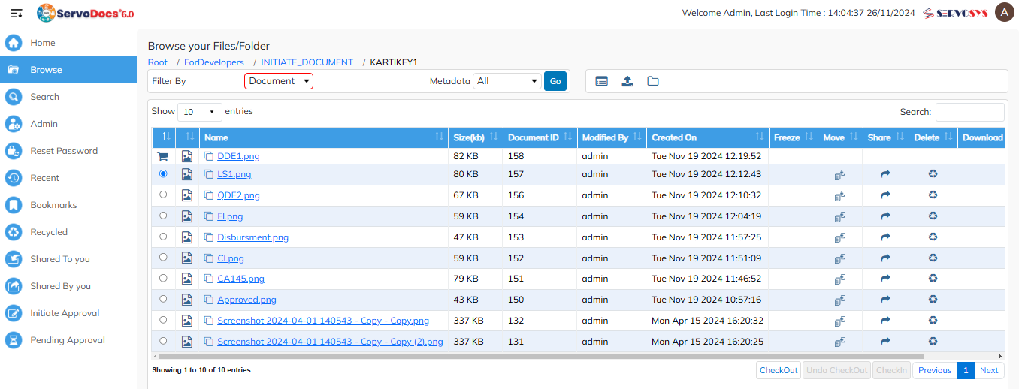
Check-Out/ Check-In Documents
ServoDocs®
Check-Out a document to prevent other users from modifying it.
Check-in a document to update a file with new version.
ServoDocs®
Enterprise Document Management System

Slide 37
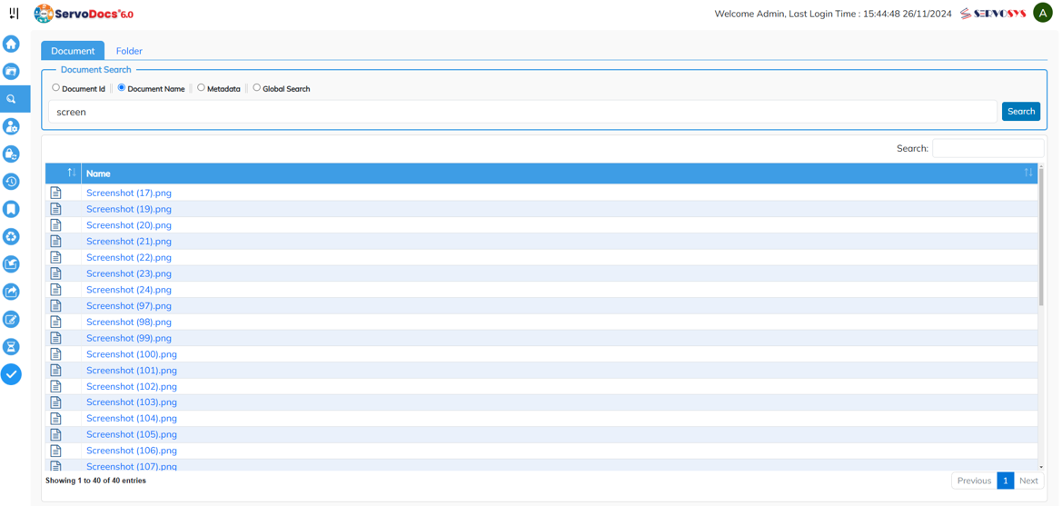
Advanced Search
ServoDocs®
Search on Document and Folder level through:
Document ID
Text Search
Folder Name
Metadata Search Parameters
ServoDocs®
Enterprise Document Management System

Slide 38
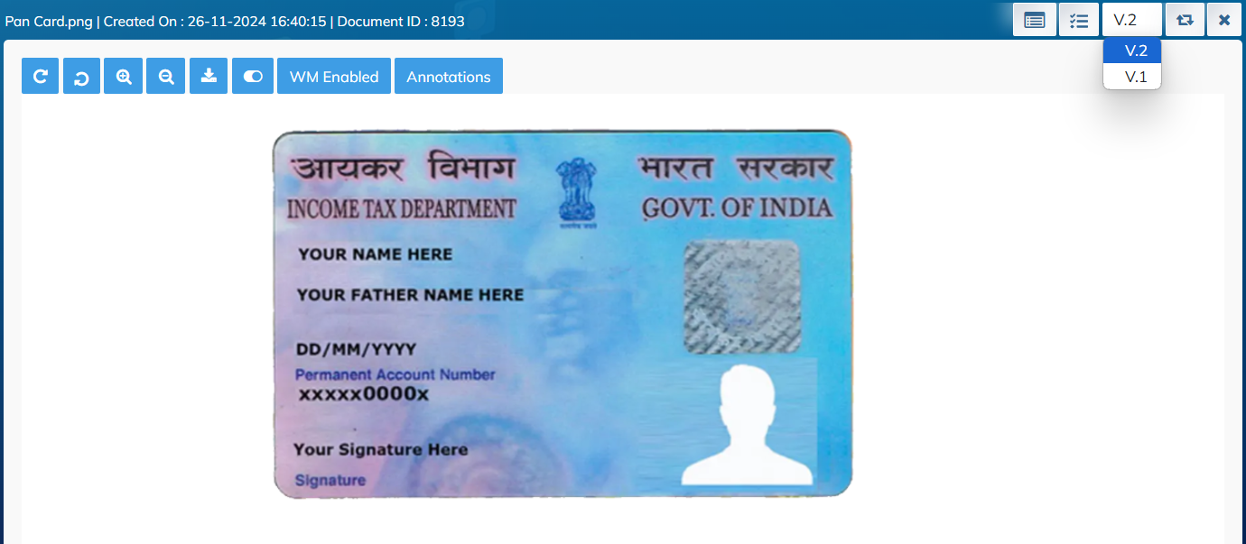
Applet-Free In-Built Viewer
ServoDocs®
The in-built web-based viewer supports all standard documents including:
JPEG/JPG
TIFF
GIFF
PDF
MP4
The viewer also supports password protected PDF files.
ServoDocs®
Enterprise Document Management System

Slide 39
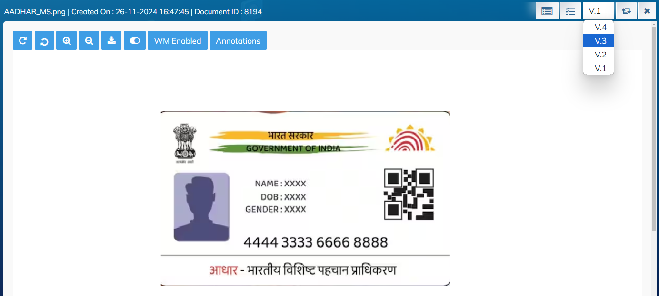
Versioning
ServoDocs®
Create any number of versions of a document.
Each version can be of a different file type
ServoDocs®
Enterprise Document Management System

Slide 40




















Technical Architecture (Micro Services)
ServoDocs Microservice based Architecture
AUTHENTICATION
-> LDAP (Internal)
-> Third Party (External)
ServoDocs Frontend calls the Microservices as required from Kubernetes Cluster
Configuration Server
INTEGRATIONS
System 1
System 2
……………
System n
Load Balancer
User Service
Active Passive Clustering
User Access from different Systems
SD Document
SD Metadata
API
Gateway
DATABASE 1
Cluster
SD Folder
Service Registry
DATABASE 2
MS SQL, Oracle, PostgreSQL, Managed Database
Storage
(SAN/ NAS/ Cloud Object Storage)
S3 Bucket, Azure BLOB, etc.
ServoDocs®
Enterprise Document Management System

Slide 41



Maker Checker Workflow
Document Upload from any Integration touchpoint
ServoDocs®
Enterprise Document Management System
Creator 1
Creator Assigns work items to different users
Create/Upload New Document
Redirect/assign work items to other users
Redirect/assign work items to other users
User 3
NOTE: Creator holds the right to revoke the work items assigned to any users.
User 1
User 2
Post User activity, Creator reviews the work items
Creator 1
Creator 1
There can be N number of Creators & Users in the system.
Based on authorizations, rights can be defined for each user in the system
Document Archival via Integrations
Document Approval
DMS
Final Approver
Final Approver

Slide 42
DMS Migration Process
Documents migration to ServoDocs
(metadata CSV & file paths.)
Documents, metadata migrated to ServoDocs via CSV
Provides a Reference ID for each document
Verification & Validation Report shared with doc/folders saved in repository
Client Verification & reconciliation of migrated documents
Migration & validations Process
Third party Apps Fetching Documents using reference_Id
Data/ document mapping (to target structure) – joint team collaboration
Unit testing Target documents (document migration testing)
Testing Support for SIT and higher environments
ServoDocs®
Enterprise Document Management System

Slide 43





DMS Migration Process
Client will provide the documents to be migrated from existing DMS to ServoDocs DMS by providing the CSV file, having metadata and location of documents in a window folder.
ServoDocs Migration Utility will pick up the CSV file, provided by the customer, and will create the folder and upload the documents and associate the respective metadata from CSV file.
This will be standard process for metadata of documents (data) for any application.
After uploading the documents, Servosys will provide a Reference ID for each document.
The other applications (LOS/ LMS/ CBS/ CRM etc.) will refer the Reference ID for fetching the documents from ServoDocs using API provided by Servosys.
Servosys will process and perform the migration & validations.
ServoDocs®
Enterprise Document Management System

Slide 44




DMS Migration Process
Verification & reconciliations on target migrated documents will be performed by the Client.
During data/ document mapping (to target structure), there should be a joint team collaboration between the Client & Servosys.
Verification and reconciliation report will be shared by Servosys containing number of documents and folders created in ServoDocs DMS.
Servosys will perform the Unit testing of the Target documents which include document migration testing.
Servosys will provide the Testing Support for SIT and higher environments.
ServoDocs®
Enterprise Document Management System

Slide 45

Servosys Commitment to Unparalleled Quality, Security & Continuity
ISO 9001:2015 High Quality
CMMI L3 V 2.0 Continuous Innovation
ISO 27001:2013 Global Security
ISO 22301:2018 Crisis Readiness
ISO 27701:2018 Data Privacy
ISO 20000:2019 Service Excellence

Slide 46
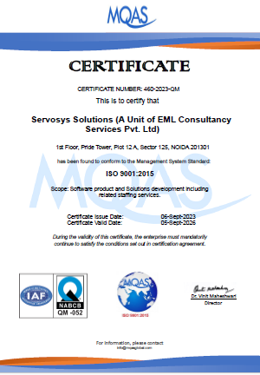
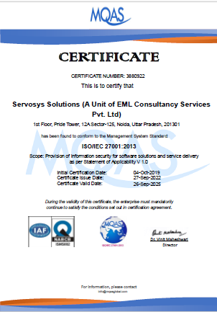
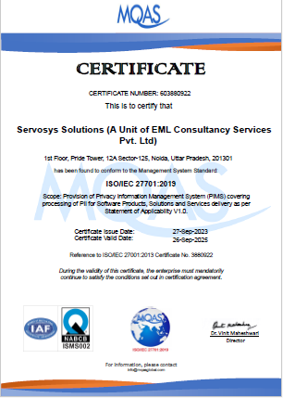
🚀 Priority to Secure, High-quality Solutions & Data Privacy Compliance
ISO 9001: Quality Management System (QMS)
  ✔️ Ensures consistent, high-quality software delivery.
  ✔️ Optimizes processes for continuous improvement.
  ✔️ Enhances customer satisfaction and trust.
ISO 27001: Information Security Management System (ISMS)
  ✔️ Protects sensitive customer data with stringent controls.
  ✔️ Ensures compliance with global data security regulations.
  ✔️ Reduces cybersecurity risks and builds client confidence.
ISO 27701: Privacy Information Management System (PIMS)
  ✔️ Ensures compliance with privacy laws (e.g., GDPR).
  ✔️ Strengthens privacy risk management and data handling.
  ✔️ Boosts customer trust with transparent data protection.

Slide 47
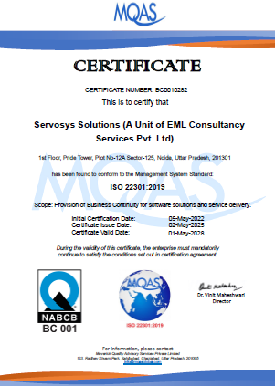
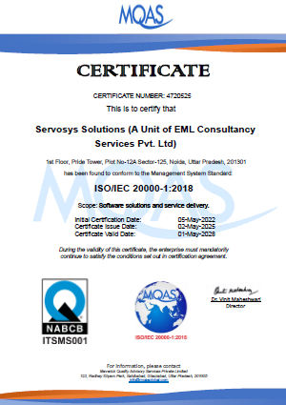
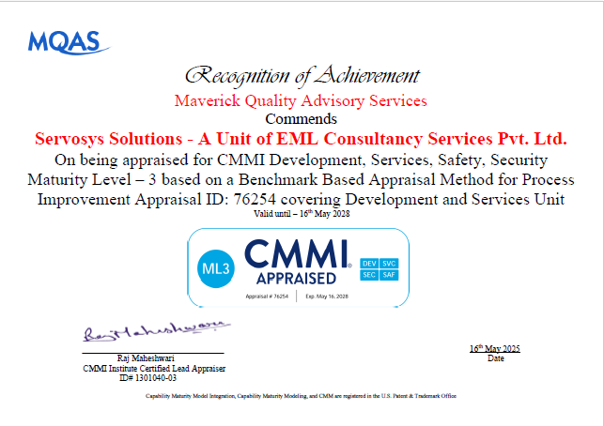
🚀 Surety To Efficient IT Delivery & Structured Process Improvement
ISO 22301: Business Continuity Management System (BCMS)
  ✔️ Ensures uninterrupted service during disruptions.
  ✔️ Reduces downtime and operational risks.
  ✔️ Demonstrates resilience and crisis readiness.
ISO 20000: IT Service Management (ITSM)
  ✔️ Delivers structured, efficient IT services.
  ✔️ Ensures reliable performance and quality assurance.
  ✔️ Enables measurable service excellence for clients.
CMMI: Capability Maturity Model Integration
  ✔️ Establishes optimized, mature software processes.
  ✔️ Enhances project efficiency and risk management.
  ✔️ Drives continuous innovation and customer-centric development.

Slide 48





Servosys Differentiators
Agile & Dynamic
Fast Implementers
Modern Technologies
Highly Configurable
Loyal Customers

Slide 49

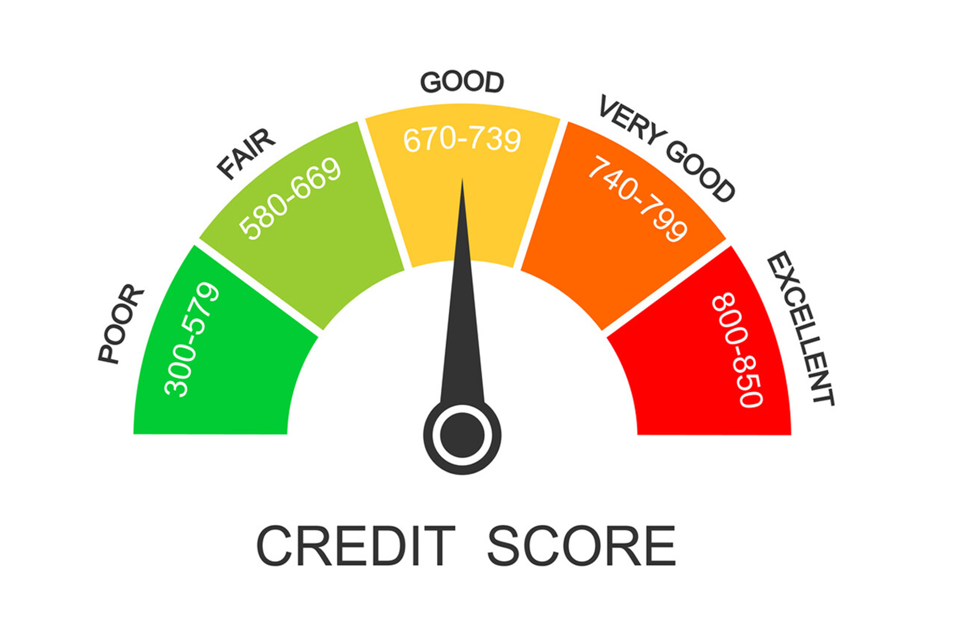




Integrations: Seamless 3rd Party Apps
KYC Integrations
Credit
Bureau
CBS, LMS, CRM
Bank Statement, ITR, eSign
Fraud &
AML
Other Integrations
UIDAI, NSDL, CERSAI, Mantra, BSmart, Velti, Aruhat, Posidex
TransUnion, Equifax, Highmark, Experian
Finacle, Flexcube FIS - Profile,
FinnOne,
Craft Silicon, Qualtech, SFDC, CRMNEXT, Clover
Perfios/ Karza, Meganet, Signzy, Digio
Experian, Hunter, Saraansh,
Probe-42
Amazon, Hitachi, Google, SquareYard, Finex, Salesforce
Integration Types: API, DB-Link, SFTP, Flat File, Enterprise Service Bus (ESB), Oracle Service Bus (OSB), LDAP, SSO

Slide 50
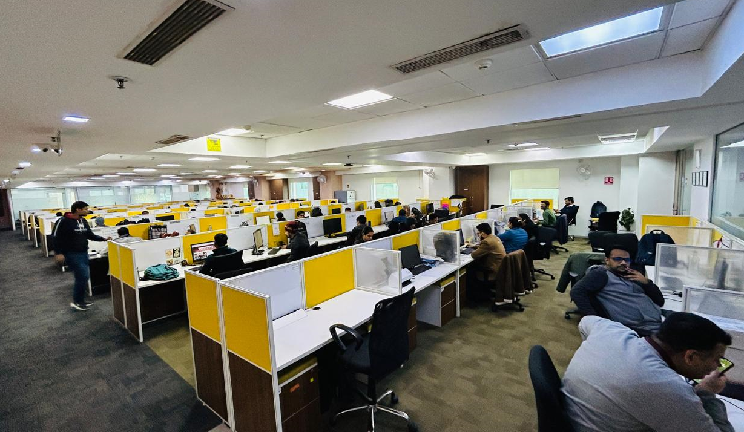

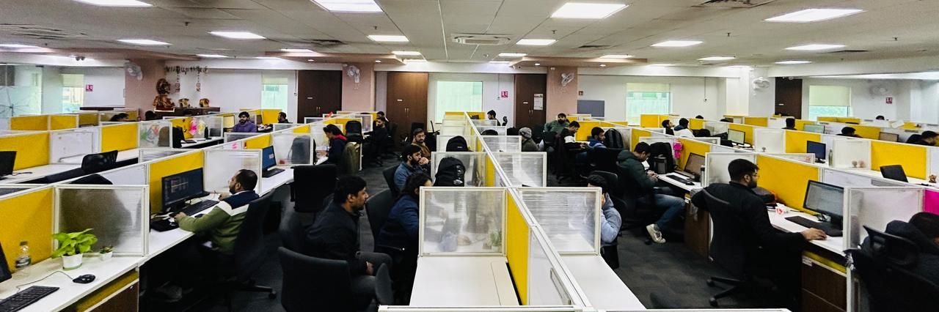

Support & Dev Center and Recognition
Support & Development Center

Slide 51




Lets Partner Together !
saleshead@servosys.com
www.servosys.com
+91-120-5112541
inquiry@servosys.com
THANK YOU!

